Slide 1
Assignment 2
Leon Carter Price
902787113

Slide 2
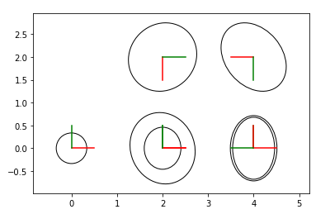
Exercise 1: Take a screen of the plot and put it on the PPT file. Give a brief explanation on why the circle are getting bigger.
As the robot moves, the location uncertainty grows due to the compounding noise of the “odometry” reading. The circles are a projection of the gaussian estimation of the location.
Plot

Slide 3
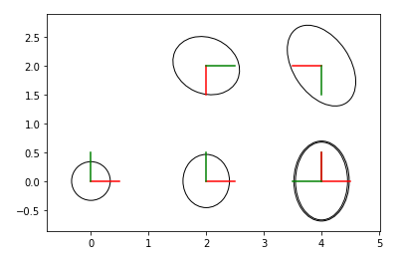
Exercise 2: Make the loop closure work. Take a screen and give a brief explanation on what happen with the covariance of each state.
State 1: roughly the same
State 2: roughly the same
State 3: the diagonal of the covariance decreased slightly (~ 0.00645)
State 4: decreased along diagonal, but had some added variance in other cells
State 5: co-variance decreased or stayed the same across all dimensions.
State 6: decreased by almost a factor of 2. Additionally the co-variance shifted slightly to have the principal component (direction of maximum variance) orthogonal to what it was without loop closure
State 7: joined with state 2-essentially removed
Plot

Slide 4
Exercise 3: Comment what happens when you don't have a prior for the initial state in the graph and relate it to the gauge freedom.
When you do not have a prior for the initial state in the graph, the code gives an error because the optimization problem is indeterminate. Without a prior, there are infinintely many possible solutions. The relative locations are defined but they could be any location (x,y) or orientation (theta). There is complete gauge freedom in SE(2); any origin could be defined in SE(2) and a valid solution could be found.

Slide 5
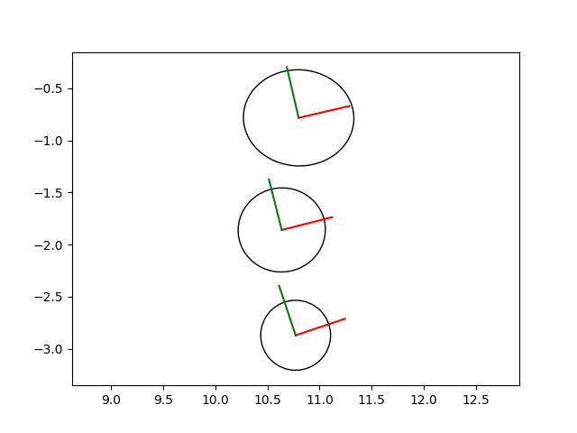
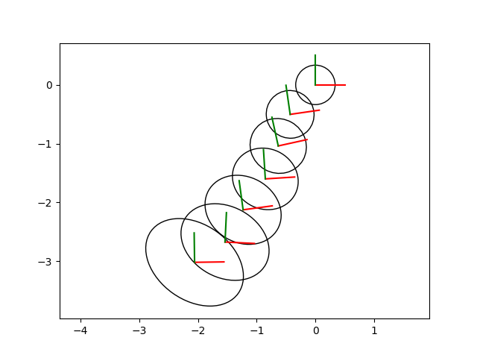
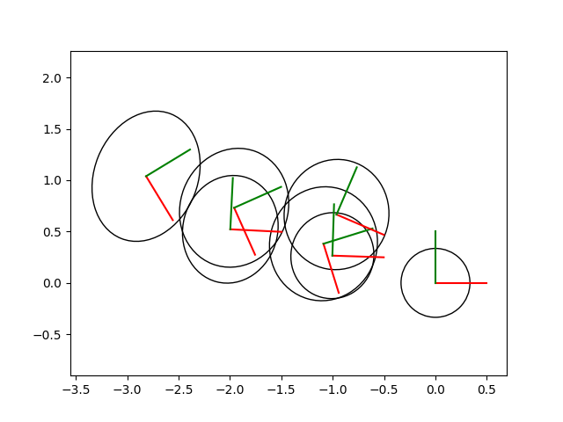
Exercise 4: Show the plot of the factor graph just like in part 1 of the assignment for three different moments in time, as you teleop the robot around. At least one of the plots needs to have a loop closure.
Plot 1
Plot 2
Plot 3
No loop closure move. The location uncertainty grows with each move. 3 times steps. Start [-3, -10.8]
No loop closure again. 7 time steps this time to emphasize the increasing uncertainty. Start: [0, 0]
With loop closure, it can clearly be seen that the location uncertainty does not grow as much through 7 time steps as the previous image. Start [0,0]

Slide 6
Exercise 5: Give a brief explanation/diagram of what is the flow of the program. Include what are the relevant topics that are being published, who subscribes to them, and a high level explanation how you use this information to create your factor graph and find loop closures.
Explanation Here
Initialize graph and estimate to current location
Do loop closure when the current odometry reading is within 0.5 of any previous odometry reading
Add new node every 1 m change in odometry
Only subscribed to Odometry topic
Used teleop with Fetch to move robot
Stored previous node locations in a dictionary for loop closure
Used msg.pose.pose.position.(x,y) to get location from Odometry
msg.pose.pose.orientation.z for angle

